Slide 1
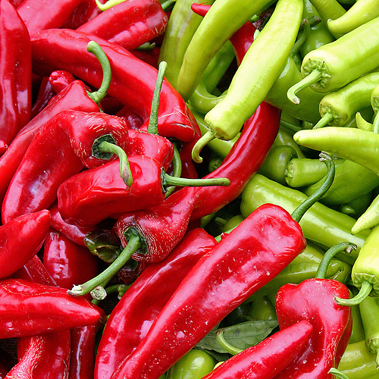
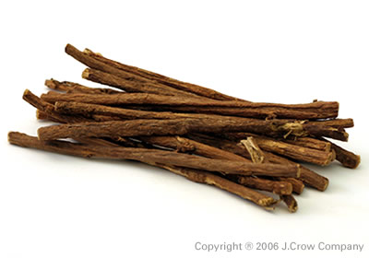
Food and health
Two powerful health foods
Licorice root
Red and green chili peppers

Slide 2
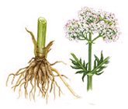
Licorice is a plant. People use the root

Slide 3


What´s the problem?
She has a cold.

Slide 4
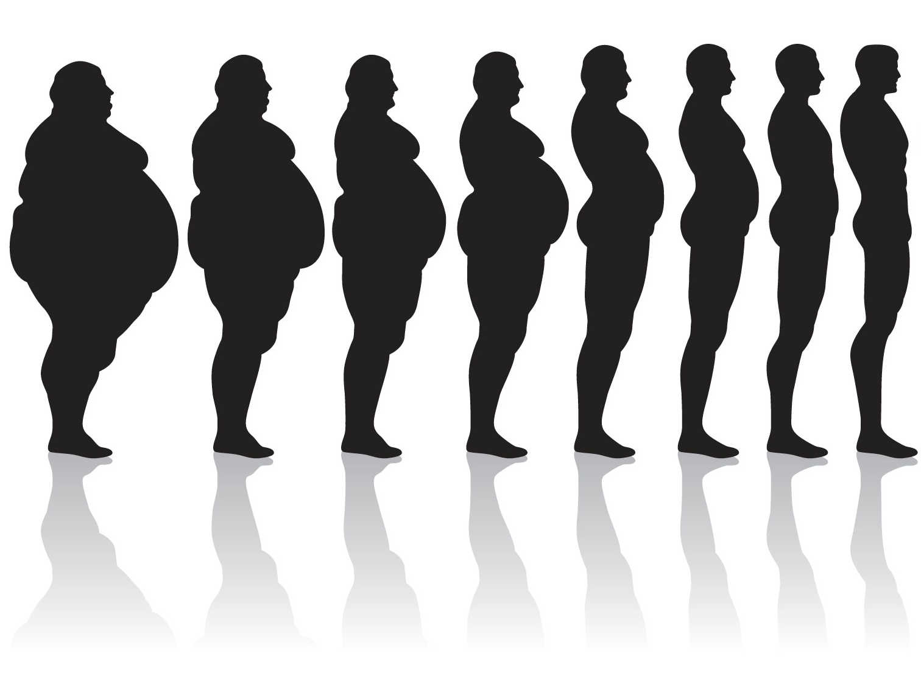
Lose … kilos

